Slide 1
Comparing Association and Causality between Risks Factors and Heart Disease
By: Tziporah Horowitz

Slide 2
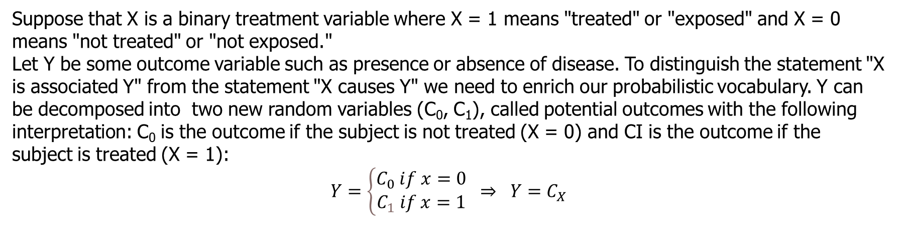
The Counterfactual Model (Wasserman 251)
Suppose that X is a binary treatment variable where X = 1 means "treated" or "exposed" and X = 0 means "not treated" or "not exposed."
Let Y be some outcome variable such as presence or absence of disease. To distinguish the statement "X is associated Y" from the statement "X causes Y" we need to enrich our probabilistic vocabulary. Y can be decomposed into two new random variables (C₀, C₁), called potential outcomes with the following interpretation: C₀ is the outcome if the subject is not treated (X = 0) and CI is the outcome if the subject is treated (X = 1):
$$Y=\left\{\begin{matrix}C_{0} ⅈf x=0 \\ C_{1} if x=1\end{matrix}\right. ⇒ Y=C_{X}$$

Slide 3
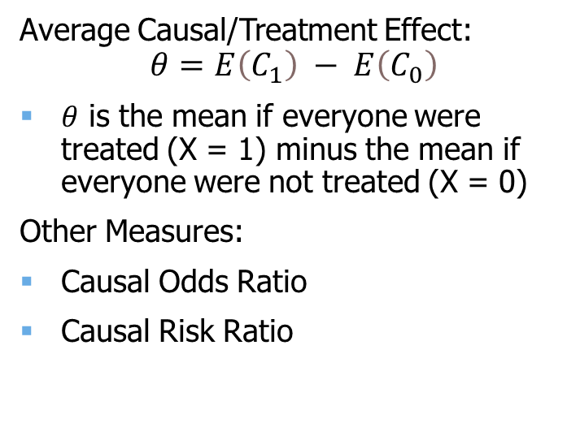
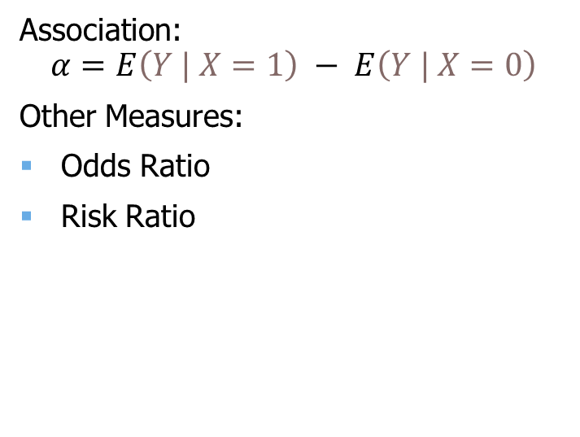
Causation vs Association
Average Causal/Treatment Effect:
$$θ=E\left(C_{1}\right) − E\left(C_{0}\right)$$
$θ$ is the mean if everyone were treated (X = 1) minus the mean if everyone were not treated (X = 0)
Other Measures:
Causal Odds Ratio
Causal Risk Ratio
Association:
$$α=E\left(Y | X=1\right) − E\left(Y | X=0\right)$$
Other Measures:
Odds Ratio
Risk Ratio
Causation
Association

Slide 4
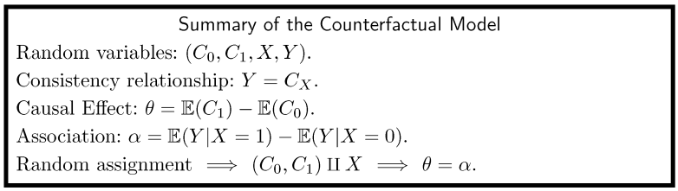

Slide 5
Methods
Logistic Regression
Parametric model that measures association via odds ratio.
Random Forests
Ensemble tree-based model that measures association by training on different permutations of the feature set.
BART (Bayesian Additive Regression Trees)
Non-parametric Bayesian model that uses a sum-of-trees approach and a regularization prior to approximate the function f(x) = E [Y | x] via Bayesian backfitting MCMC.
Hill proposed using BART to estimate the average treatment effect in non-experimental settings due to its inherent calculation of f(x). [Hill, J. L. (2011)]

Slide 6
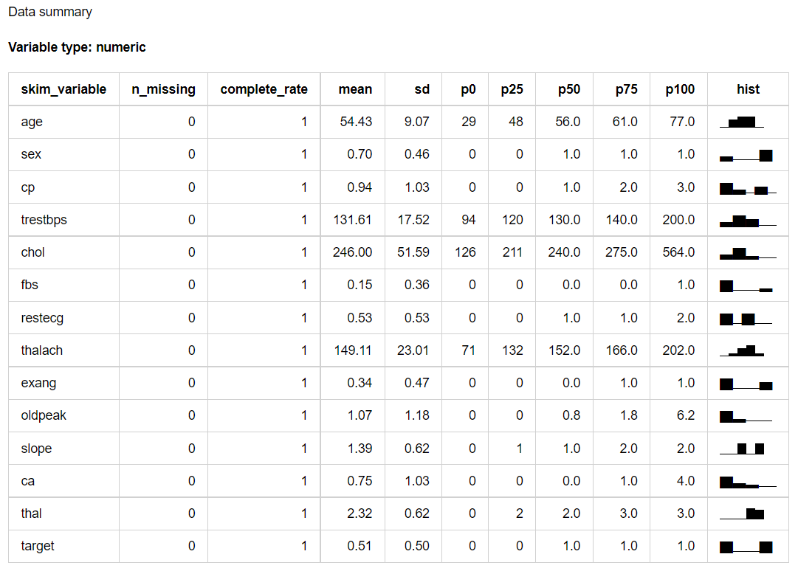
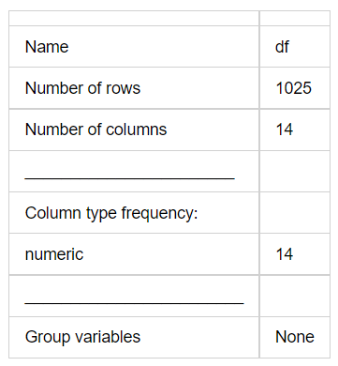
Heart Disease Dataset

Slide 7
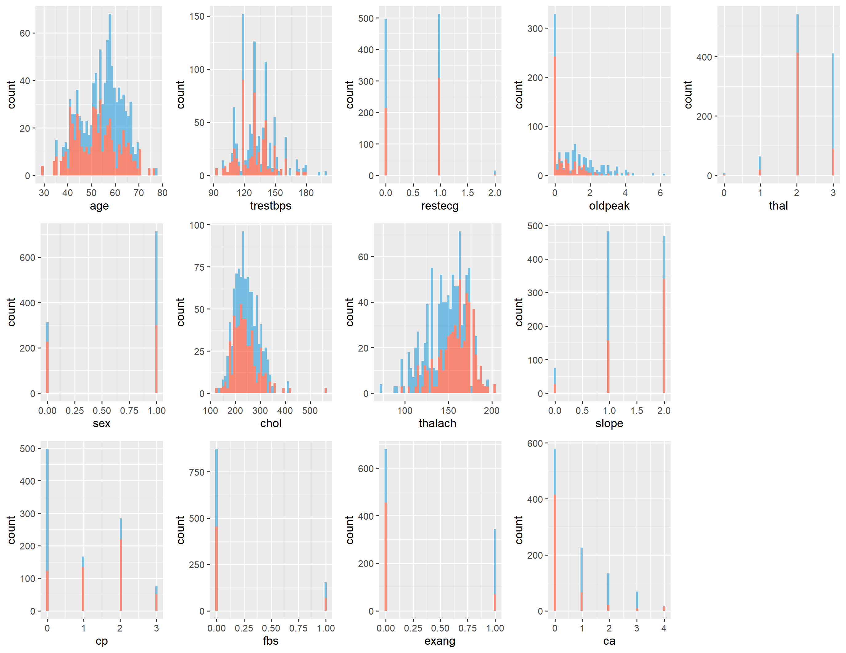
Blue = 0
Red = 1

Slide 8
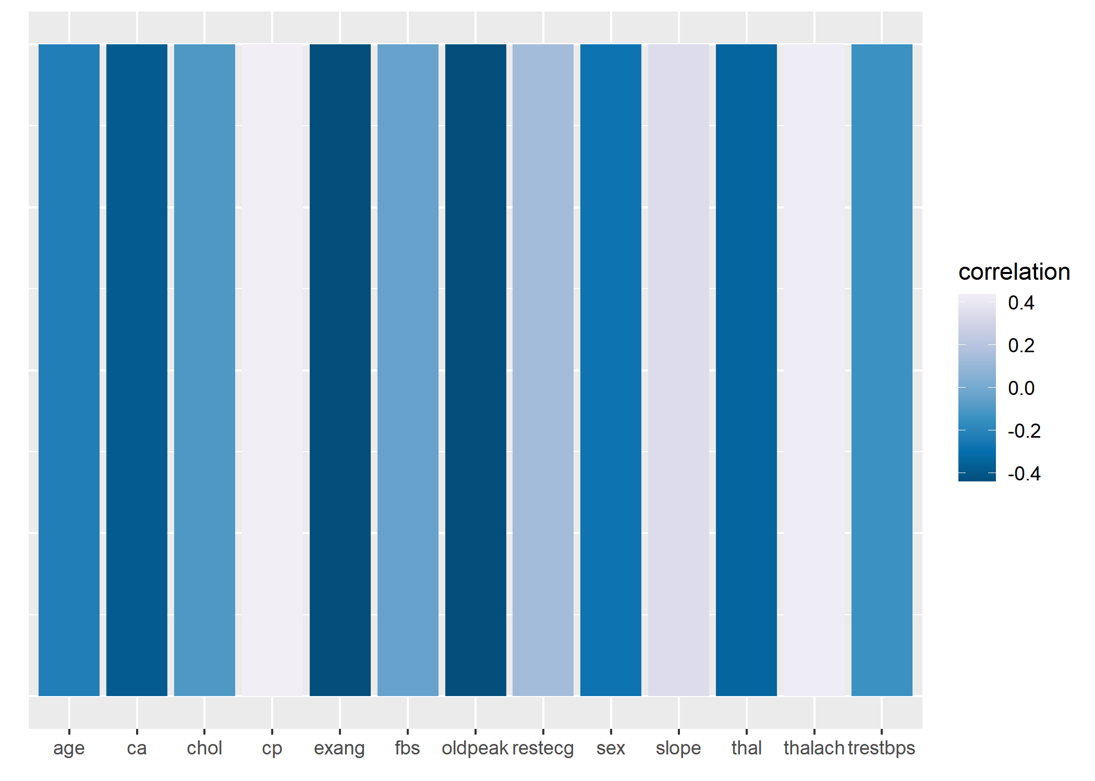

Slide 9
Logistic Regression
 | Estimate | Odds Ratio | Std..Error | z.value | Pr...z..
(Intercept) | -0.64141 | 0.5265499 | 2.510612 | -0.25548 | 0.798353
age | 0.022203 | 1.0224512 | 0.018604 | 1.193454 | 0.232692
sex | -1.74857 | 0.1740235 | 0.397958 | -4.39384 | 1.11E-05 | ***
resting blood pressure | -0.01984 | 0.9803555 | 0.00855 | -2.32055 | 0.020311 | *
serum cholesterol | -0.00526 | 0.9947538 | 0.002888 | -1.82103 | 0.068602 | .
fasting blood sugar > 120 mg/dl | 0.296628 | 1.3453154 | 0.409241 | 0.724825 | 0.468559
maximum heart rate achieved | 0.022726 | 1.0229864 | 0.009033 | 2.515982 | 0.01187 | *
exercise induced angina | -0.79549 | 0.4513584 | 0.329639 | -2.41323 | 0.015812 | *
oldpeak | -0.34802 | 0.7060858 | 0.180994 | -1.92282 | 0.054503 | .
chest pain = 1 | 0.961956 | 2.6168104 | 0.395997 | 2.429199 | 0.015132 | *
chest pain = 2 | 2.028971 | 7.6062587 | 0.36538 | 5.553045 | 2.81E-08 | ***
chest pain = 3 | 2.558827 | 12.920656 | 0.579411 | 4.416254 | 1.00E-05 | ***
resting electrocardiograph = 1 | 0.150976 | 1.1629688 | 0.281241 | 0.536822 | 0.591391
resting electrocardiograph = 2 | -1.16097 | 0.3131812 | 2.173118 | -0.53424 | 0.593173
slope = 1 | -0.61958 | 0.5381692 | 0.567822 | -1.09116 | 0.275204
slope = 2 | 0.673433 | 1.9609582 | 0.601172 | 1.120201 | 0.262628
major vessels colored = 1 | -2.44333 | 0.0868715 | 0.359945 | -6.78805 | 1.14E-11 | ***
major vessels colored = 2 | -3.2715 | 0.0379494 | 0.566718 | -5.77271 | 7.80E-09 | ***
major vessels colored = 3 | -2.24503 | 0.1059246 | 0.810761 | -2.76904 | 0.005622 | **
major vessels colored = 4 | 1.022481 | 2.7800848 | 1.355826 | 0.754139 | 0.450766
thalassemia = 1 | 2.244612 | 9.4367565 | 1.744049 | 1.287012 | 0.19809
thalassemia = 2 | 2.269069 | 9.6703935 | 1.682617 | 1.348535 | 0.177486
thalassemia = 3 | 0.811895 | 2.2521726 | 1.682796 | 0.482468 | 0.629473

Slide 10
Random Forests
 | left daughter | right daughter | split var | split point | status | prediction
1 | 2 | 3 | thalassemia = 3 | 0.5 | 1 | NA
2 | 4 | 5 | maximum heart rate achieved | 113.5 | 1 | NA
3 | 6 | 7 | resting blood pressure | 109 | 1 | NA
4 | 0 | 0 | NA | 0 | -1 | 0
5 | 8 | 9 | oldpeak | 2.5 | 1 | NA
6 | 10 | 11 | maximum heart rate achieved | 155 | 1 | NA
7 | 12 | 13 | chest pain = 3 | 0.5 | 1 | NA
8 | 14 | 15 | age | 55.5 | 1 | NA
9 | 16 | 17 | age | 40.5 | 1 | NA
10 | 0 | 0 | NA | 0 | -1 | 1
11 | 18 | 19 | chest pain = 1 | 0.5 | 1 | NA
12 | 20 | 21 | chest pain = 2 | 0.5 | 1 | NA
13 | 0 | 0 | NA | 0 | -1 | 1
14 | 22 | 23 | major vessels colored = 3 | 0.5 | 1 | NA
15 | 24 | 25 | serum cholesterol | 248.5 | 1 | NA
16 | 0 | 0 | NA | 0 | -1 | 1
17 | 26 | 27 | maximum heart rate achieved | 147.5 | 1 | NA
18 | 0 | 0 | NA | 0 | -1 | 0
19 | 0 | 0 | NA | 0 | -1 | 1

Slide 11
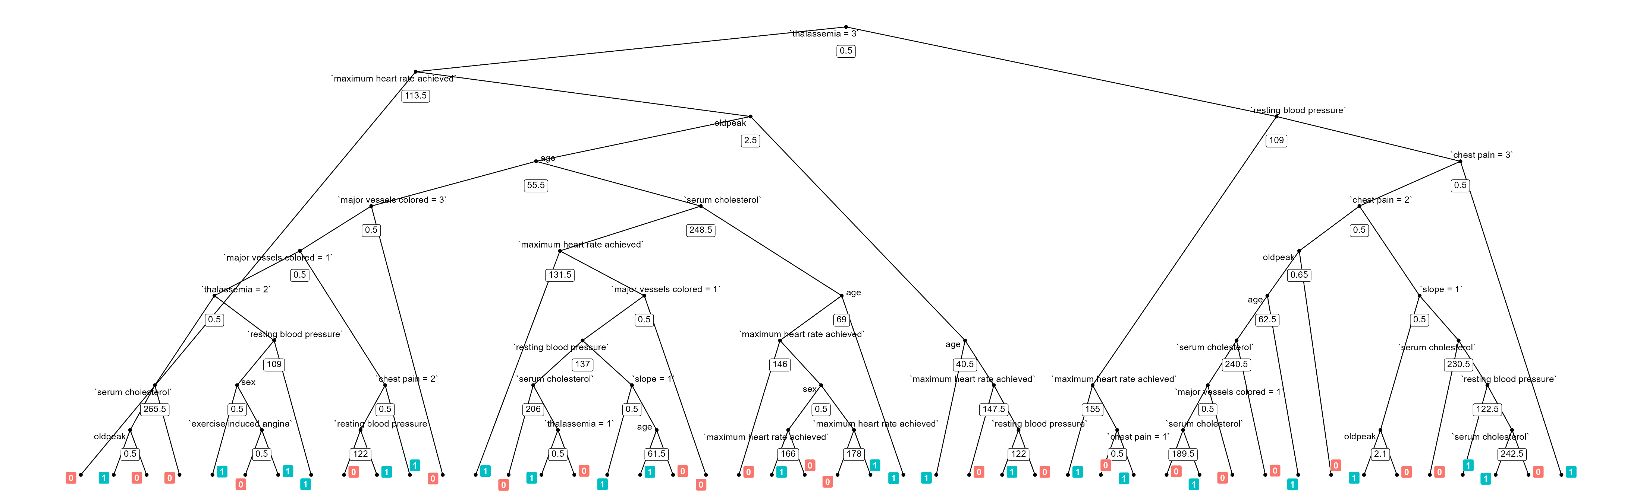
Random Forests

Slide 12
BART
bartMachine v1.3.3.1 for classification
training data size: n = 615 and p = 22
built in 1.9 secs on 4 cores, 50 trees, 250 burn-in and 1000 post. samples
confusion matrix:
 | predicted 0 | predicted 1 | model errors
actual 0 | 273 | 33 | 0.108
actual 1 | 15 | 294 | 0.049
use errors | 0.052 | 0.101 | 0.078

Slide 13
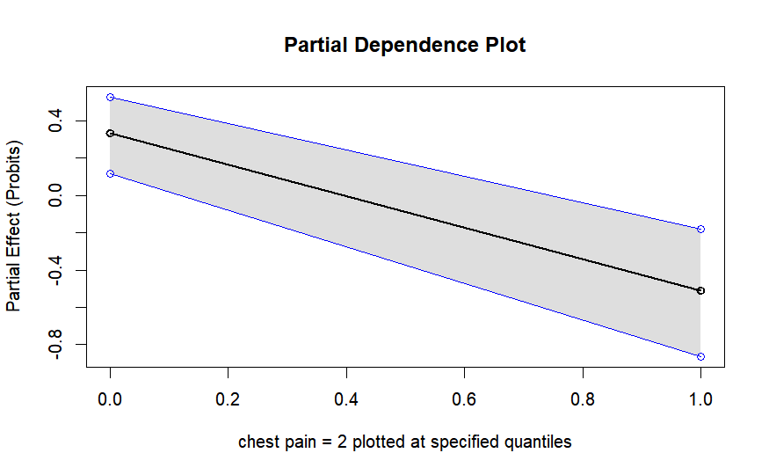
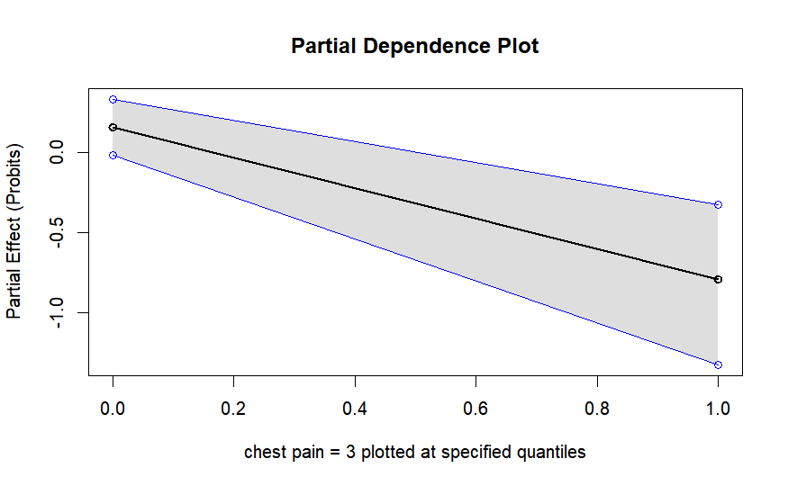
BART

Slide 14
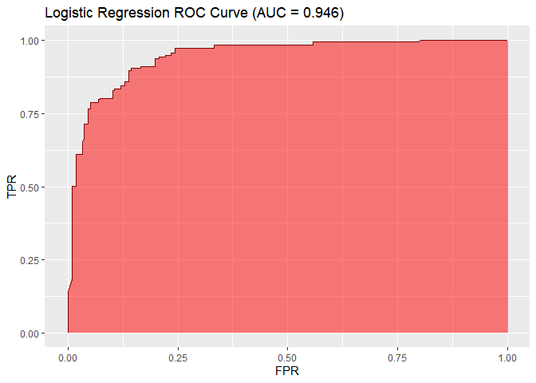
Scoring – Logistic Regression
Optimal Threshold: p = 0.621

Slide 15
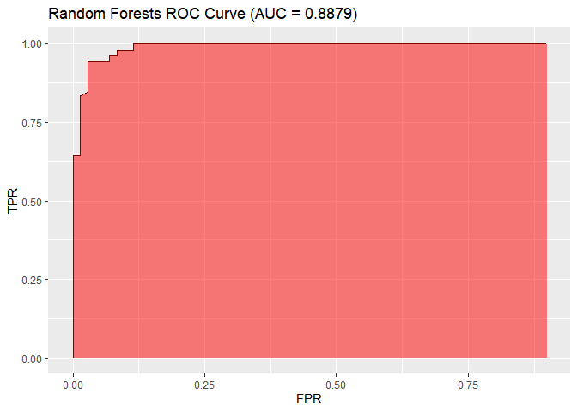
Scoring – Random Forests
Optimal Threshold: p = 0.44

Slide 16
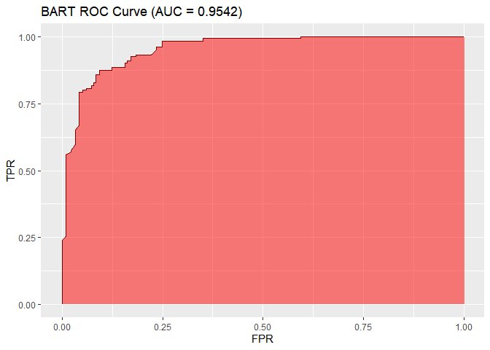
Scoring – BART
Optimal Threshold: p = 0.507

Slide 17
Code
https://github.com/TzipHoro/ACM726-CausalInference/tree/master

